Slide 1
Fuzzy Critter Battles
The Nikola Tesla’s
Ryan Babcock, Stacy Carlson, and Laura Humphreys

Slide 2
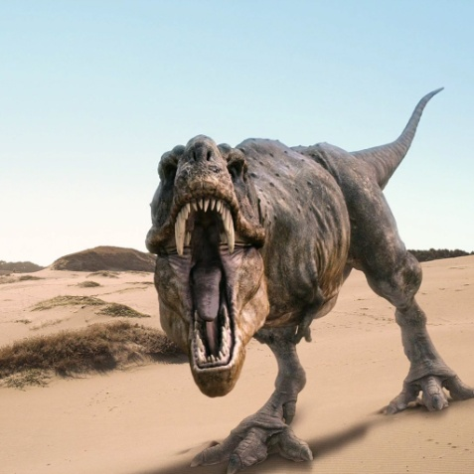

Basic Game Idea
Dungeon crawler
2 Sizes
3 Levels
Cute fuzzy critters battle scary critters while piloting robots

Slide 3
Patterns Used
Decorator
Robots
Factory
Actions
Game Characters
Images
Mediator
Battle Window
Singleton
Robot Factory
Strategy
Special Actions

Slide 4
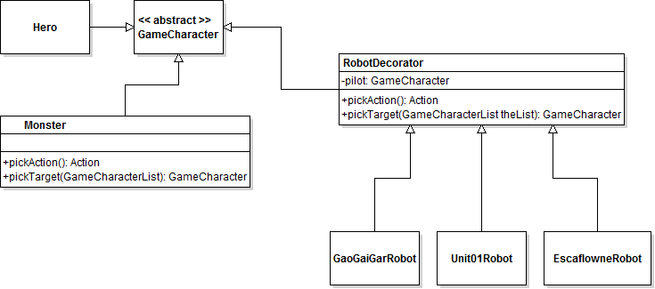
Robot Decorator

Slide 5
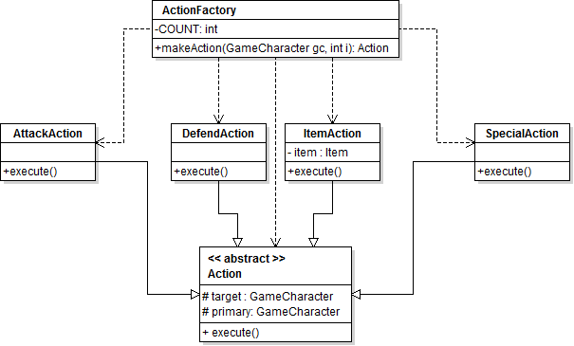
Action Factory

Slide 6
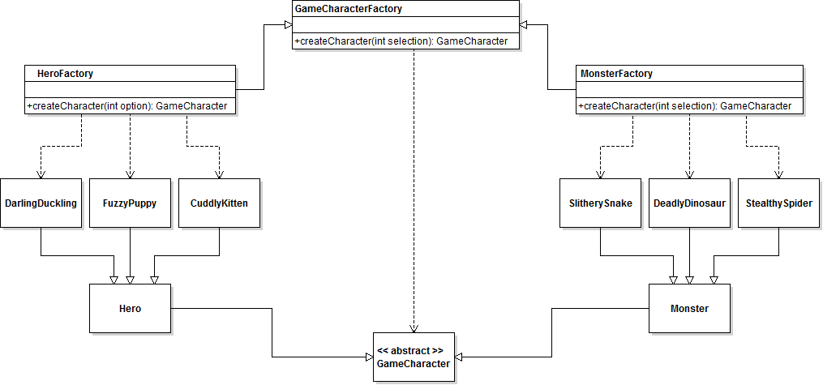
Game Character Factory

Slide 7

Image Factory

Slide 8
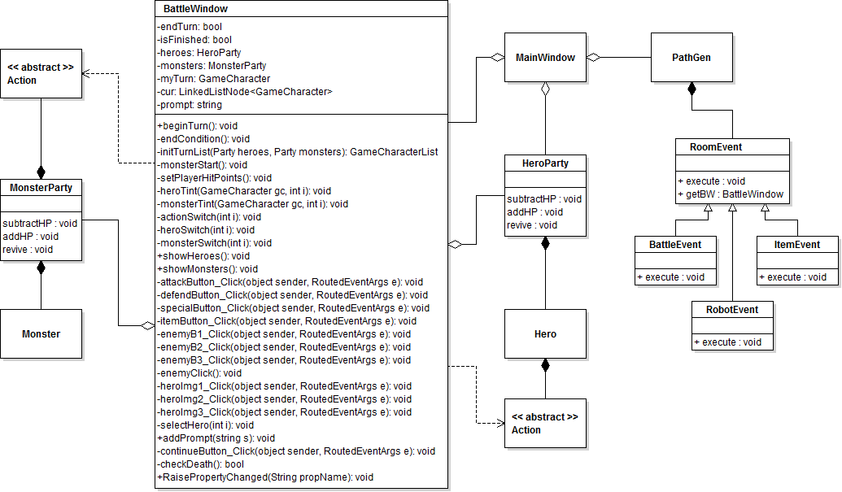
Battle Window

Slide 9
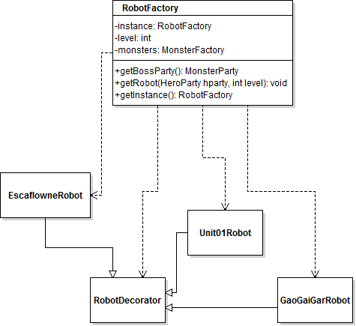
Robot Factory

Slide 10
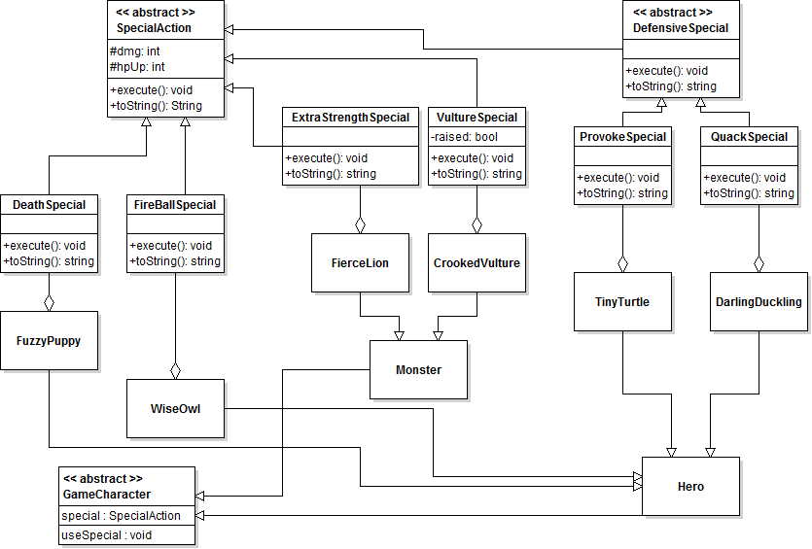
Special Actions

Slide 11
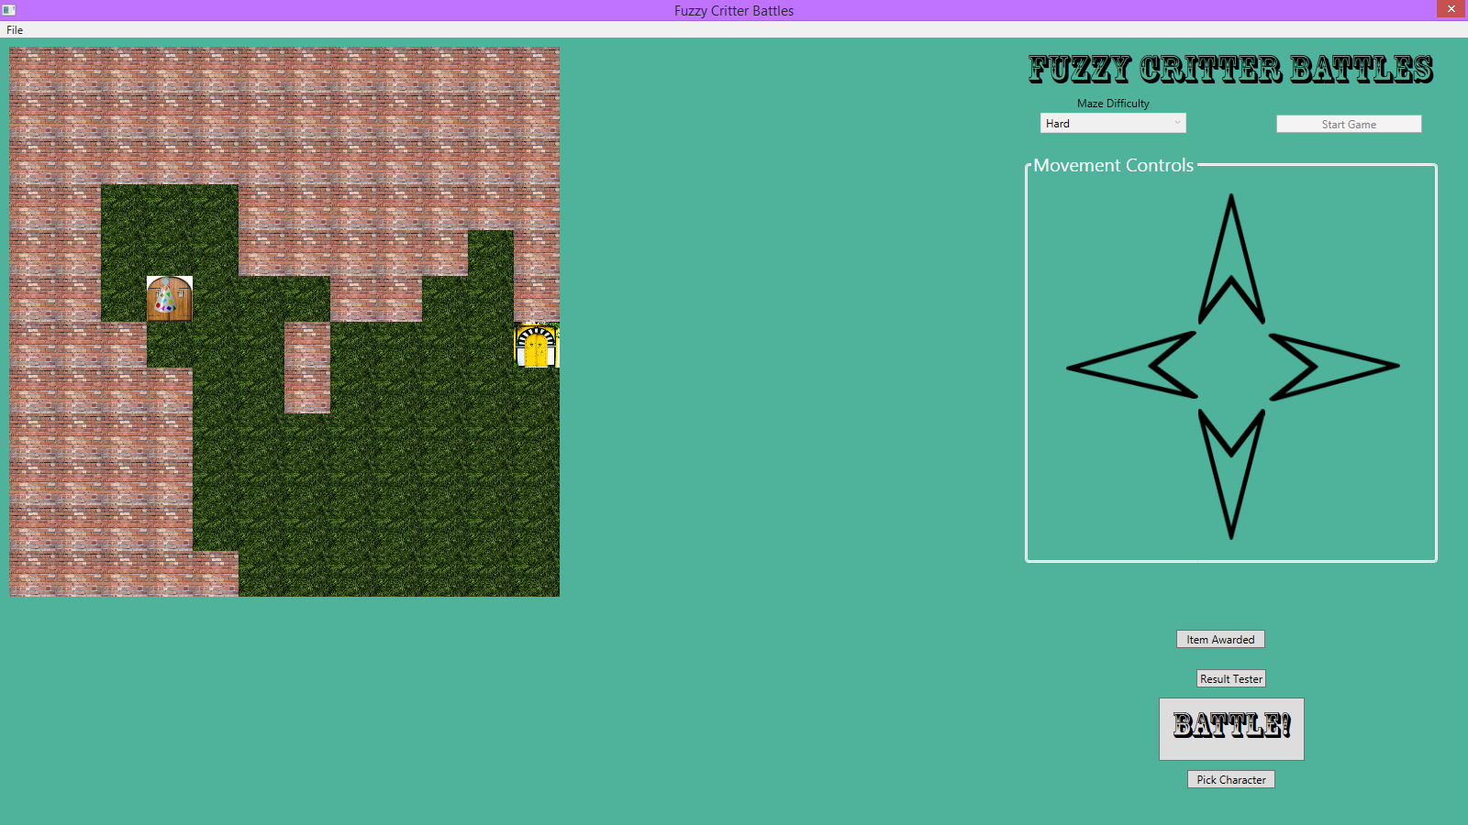
Demonstration!

